Slide 1

AI-POWERED SMART SURVEILLANCE SYSTEM

Slide 2

PROBLEM STATEMENT
Traditional surveillance systems rely on manual monitoring, leading to delays in threat detection and response. AI-powered surveillance aims to address these challenges by enabling real-time, automated monitoring, reducing human intervention while improving security and accuracy.

Slide 3
ABSTRACT
This project focuses on developing an AI-powered surveillance system that utilizes advanced machine learning, computer vision, and IoT technologies. The system enhances security by automating anomaly detection, facial recognition, and real-time alerts. Future enhancements include predictive analytics, IoT sensor integration, and cloud-based remote monitoring.

Slide 4
INTRODUCTION
AI-powered surveillance systems leverage deep learning and IoT technologies to provide automated, real-time security monitoring. They detect suspicious activities, recognize faces, and send instant alerts, reducing the need for manual supervision. This system can be applied in smart cities, industries, and public safety.

Slide 5
KEY FEATURE
AI-Based Object Detection and Facial Recognition
Real-Time Monitoring and Anomaly Detection
Edge Computing for Low Latency Processing
Secure Cloud Storage for Surveillance Data
IoT Integration for Enhanced Security
Remote Access via Mobile and Web Applications

Slide 6
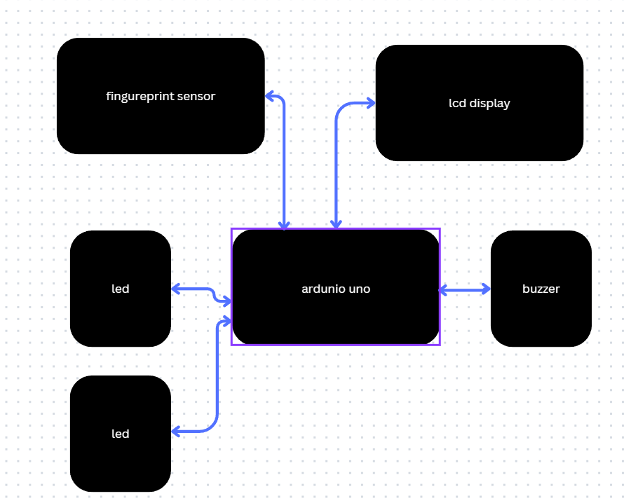
BLOCK DIAGRAM

Slide 7
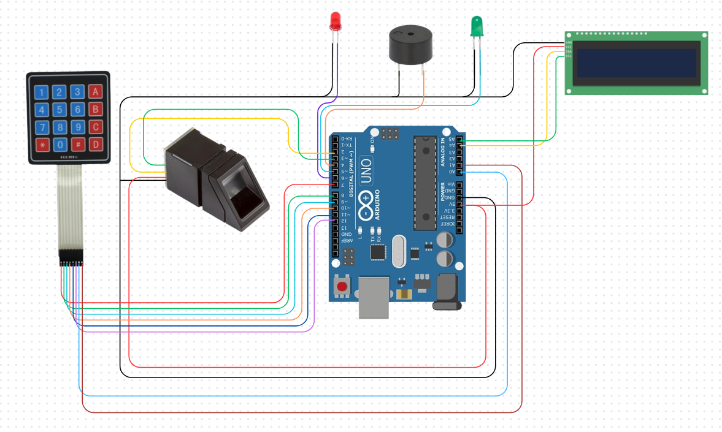
CIRCUIT DIAGRAM

Slide 8
USE CASE
Public Safety & Law Enforcement
Smart City Surveillance & Traffic Monitoring
Industrial & Corporate Security
Home & Commercial Security
Automated Threat Detection in Restricted Areas

Slide 9
OUTCOME
•Real-time, AI-powered threat detection and monitoring
Improved security with automated alerts
Reduced human intervention in surveillance tasks
Scalable and adaptable for various environments
Enhanced privacy and data security measures

Slide 10
CONCLUSION
The AI-powered smart surveillance system is an advanced security solution that leverages AI, IoT, and cloud computing for real-time monitoring. With continuous improvements, this technology will enhance security in public spaces, industries, and smart cities, reducing crime and improving response times.

